Slide 1
Module 1 Hadoop
Dr. S. Nandagopalan, Ph. D

Slide 2
Agenda
Hadoop Distributed File System Basics
Running Example Programs and Benchmarks
Hadoop MapReduce Framework
MapReduce Programming
Summary

Slide 3

Text Book

Slide 4
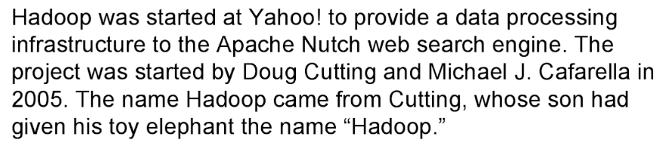
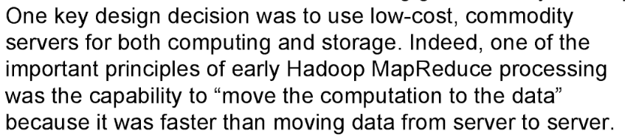
History of Hadoop

Slide 5
Hadoop at Yahoo!
Building Internet-scale search engines requires huge amounts of data and therefore large numbers of machines to process it. Yahoo! Search consists of four primary components:
Crawler, which downloads pages from web servers; the WebMap, which builds a graph of the known Web;
Indexer, which builds a reverse index to the best pages;
Runtime, which answers users’ queries.
WebMap is a graph that consists of roughly 1 trillion (1012) edges, each representing a web link, and 100 billion (1011) nodes, each representing distinct URLs.
Creating and analyzing such a large graph requires a large number of computers running for many days.

Slide 6
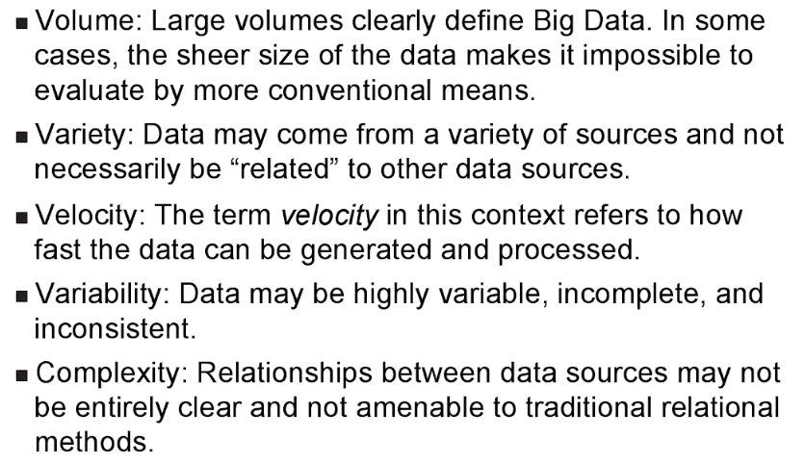
What is Big Data?

Slide 7
Big Data
Typical large enterprise:
5,000-50,000 servers, Terabytes of data, millions of Txn per day.
In contrast, many Internet companies
Millions of servers, petabytes of data
Google:
Lots and lots of Web pages
Billions of Google queries per day
Facebook:
A billion Facebook users
Billion+ Facebook pages
Twitter:
Hundreds of million Twitter accounts
Hundreds of million Tweets per day

Slide 8


Data Analytics & Mining Solutions
Google, Facebook, LinkedIn, eBay, Amazon... didnot use the traditional data warehouse products for DAM.
Why? CAP theorem
Different assumptions lead to different solutions
What?
Massive parallism
Hadoop MapReduce paradigm
UC Berkeley shark/spark

Slide 9
What is Big Data Analytics?
Big data is the term for a collection of data sets so large and complex that it becomes difficult to process using on-hand database management tools or traditional data processing applications.
The challenges include capture, curation, storage search, sharing, transfer, analysis and visualization

Slide 10
Dealing with Data

Slide 11
Platforms for Big Data Mining
Parallel DBMS technologies
Proposed in the late eighties
Matured over the last two decades
Multi-billion dollar industry: Proprietary DBMS Engines
intended as Data Warehousing solutions for very large enterprises
Hadoop
Spark
UC Berkeley

Slide 12
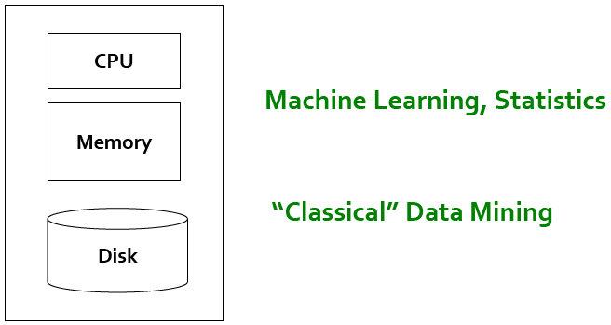
Single Node Architecture

Slide 13
Motivation: Google Example
20+ billion web pages x 20KB = 400+ TB
1 computer reads 30-35 MB/sec from disk ▪
~4 months to read the web
Takes even more to do something useful with the data!
Recently standard architecture for such problems emerged: ▪
Cluster of commodity Linux nodes
Commodity network (ethernet) to connect them

Slide 14
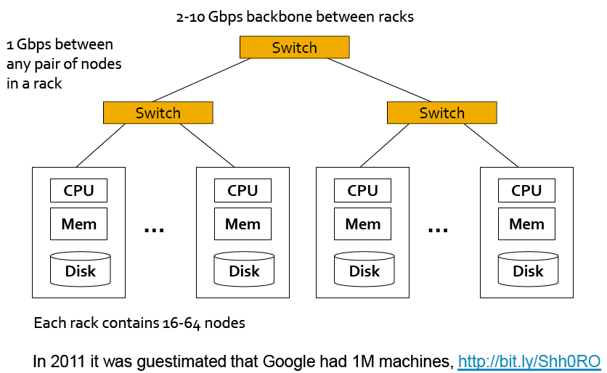
Cluster Architecture

Slide 15
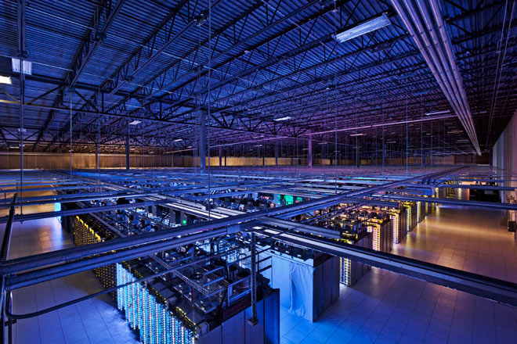
Google server room in Council Bluffs, Iowa
Data centers consume up to 1.5 percent of all the world’s electricity
The huge fans sound like jet engines jacked through Marshall amps.

Slide 16
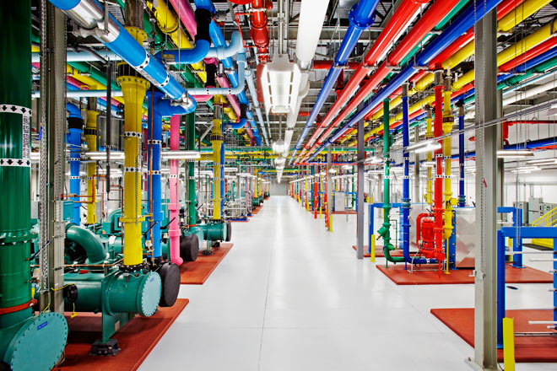
A central cooling plant in Google’s Douglas County, Georgia, data center

Slide 17
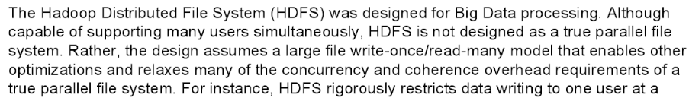
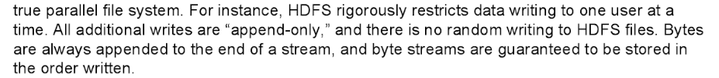
Hadoop’s HDFS

Slide 18
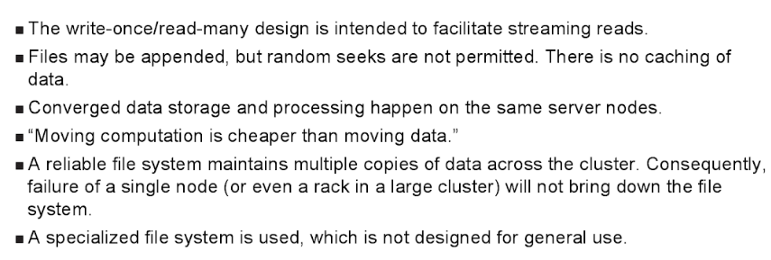
HDFS

Slide 19


HDFS versus NFS
Network File System (NFS)
Hadoop Distributed File System (HDFS)
Single machine makes part of its file system available to other machines
Sequential or random access
PRO: Simplicity, generality, transparency
CON: Storage capacity and throughput limited by single server
Single virtual file system spread over many machines
Optimized for sequential read and local accesses
PRO: High throughput, high capacity
CON: Specialized for particular types of applications

Slide 20
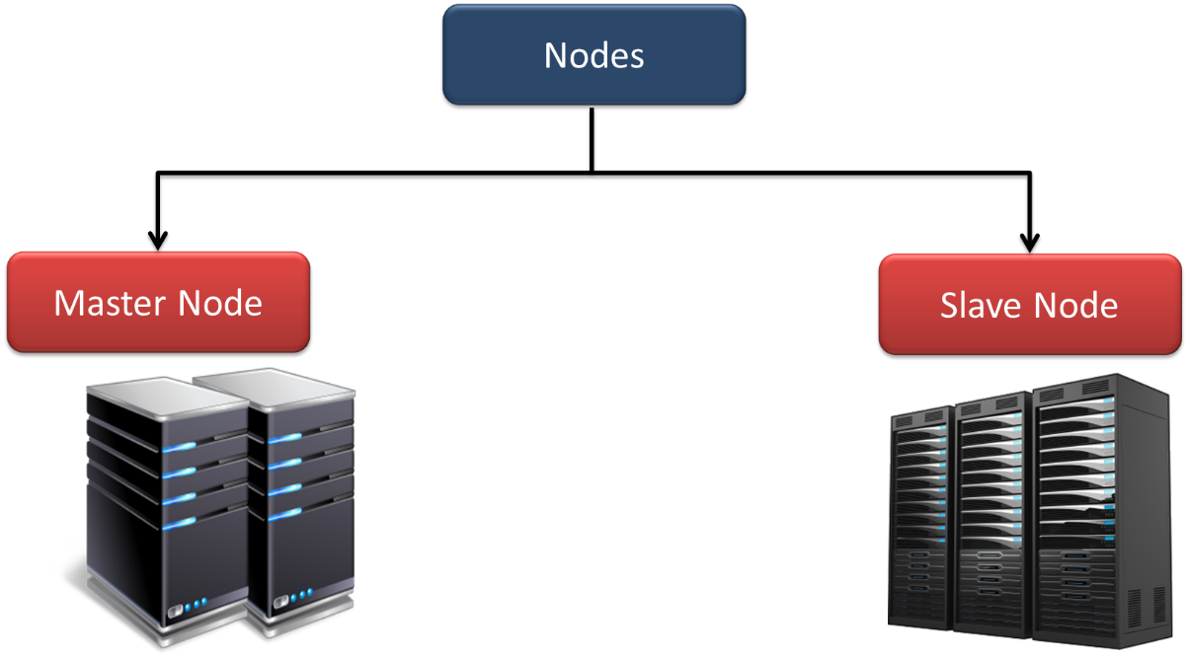
HDFS-Overview
Hadoop works in master-slave fashion, HDFS also has 2 types of nodes that work in the same manner. There are namenode(s) and datanodes in the cluster.

Slide 21


How data is stored in HDFS
foo.txt: 3,9,6 bar.data: 2,4
block #9 of foo.txt?
3
9
Name node
4
9
2
6
9
Read block 9
2
3
4
9
6
2
4
3
9
Client
Data nodes
Files are stored as sets of (large) blocks
Default block size: 64 MB (ext4 default is 4kB!)
Blocks are replicated for durability and availability
What are the advantages of this design?
Namespace is managed by a single name node
Actual data transfer is directly between client & data node
Pros and cons of this decision?

Slide 22
NameNode
Namenode regulates file access to the clients.
It maintains and manages the slave nodes and assign tasks to them.
Namenode executes file system namespace operations like opening, closing, and renaming files and directories.
Name node stores metadata like filename, the number of blocks, number of replicas, a location of blocks, block IDs etc.
This metadata is available in memory in the master for faster retrieval of data.
It should be deployed on reliable hardware.

Slide 23
DataNodes
There are n number of slaves (where n can be upto 1000) or data nodes in Hadoop Distributed File System which manage storage of data.
These slave nodes are the actual worker nodes which do the tasks and serve read and write requests from the file system’s clients.
They also perform block creation, deletion, and replication upon instruction from the NameNode.
Once a block is written on a datanode, it replicates it to other datanode and process continues until the number of replicas mentioned is created.
Datanodes can be deployed on commodity Hardware and we need not deploy them on very reliable hardware

Slide 24
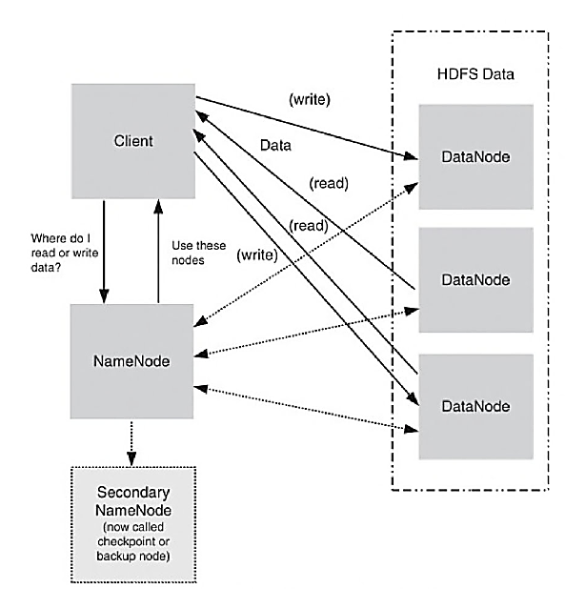
HDFS Components
HDFS uses a master/slave model.
NameNode is a metadata server or “data traffic cop”
HDFS provides a single namespace that is managed by the NameNode.
No data on the NmaeNode.
SecendaryNameNode performs checkpoints of NameNode file system’s state.

Slide 25
HDFS Block Replication
When HDFS writes a file, it is replicated across the cluster. It depends on dfs, replication in the hdfs-site.xml file.
More than 8 DataNodes: replication = 3
Less than 8 DataNodes: replication = 2.
Single Node: replication = 1.
HDFS blocks are based on size; splits are based on logical partitioning of data.
Default block size = 64MB

Slide 26
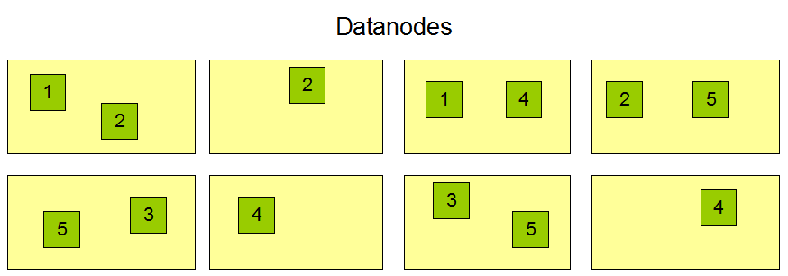
Example
Data file (64MB blocks)
1 | 2 | 3 | 4 | 5
3
3
5
1
3
4
1
2
2
5
4
2

Slide 27
Rack Awareness
Hadoop runs on a cluster of computers which are commonly spread across many racks.
NameNode places replicas of a block on multiple racks for improved fault tolerance.
NameNode tries to place at least one replica of a block in each rack, so that if a complete rack goes down then also system will be highly available.
The purpose of a rack-aware replica placement policy is to improve data reliability, availability, and network bandwidth utilization.

Slide 28
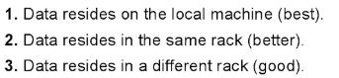
Best Policy

Slide 29
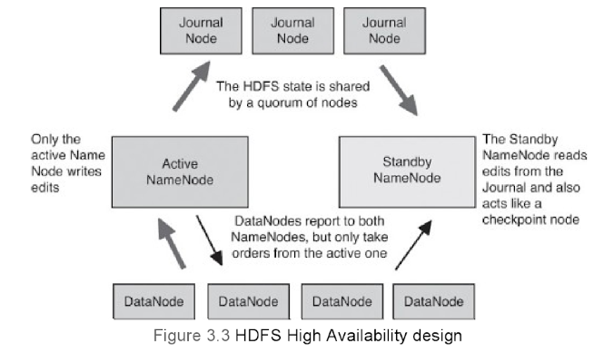
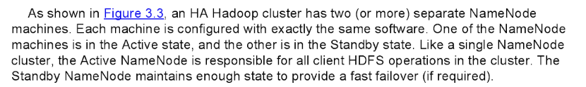
NameNode High Availability
If NameNode fails…….the entire Hadoop cluster is gone…..????

Slide 30
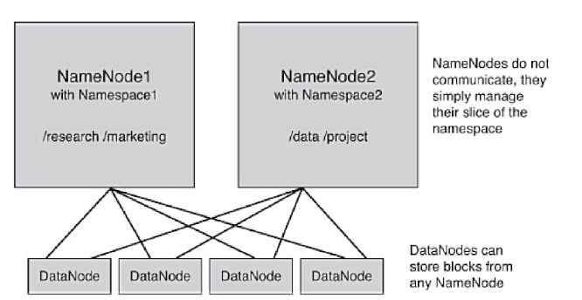
HDFS NameNode Federation
Federation in Hadoop uses multiple independent Namenode/namespaces to scale the name service horizontally.
In HDFS Federation Architecture, at the bottom, datanodes are present.
And datanodes are used as common storage for blocks by all the namenodes.
Each datanodes registers with all the namenodes in the cluster.
These datanodes send periodic heartbeats, block report and handle command from the namenodes.

Slide 31
Other HDFS Concepts
HDFS Checkpoints & Backups
HDFS Snapshots
HDFS NFS Gateway

Slide 32
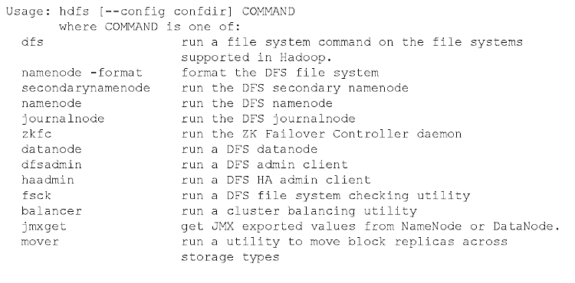
HDFS User Commands

Slide 33
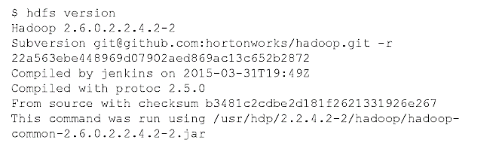
General HDFS Commands

Slide 34
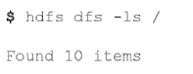
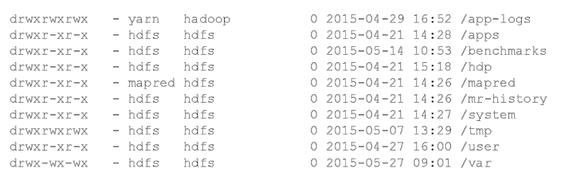
List Files in root HDFS

Slide 35
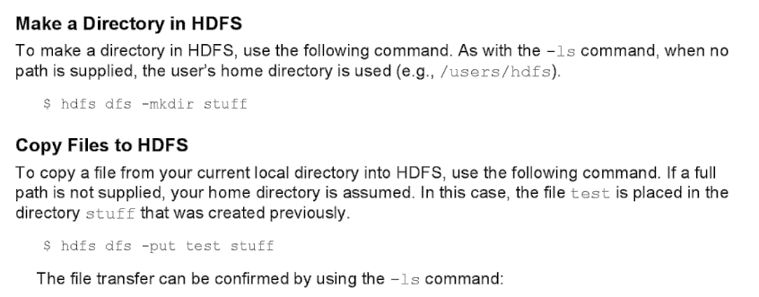
Other Commands

Slide 36
Hadoop MapReduce Framework

Slide 37
MapReduce Model
Hadoop MapReduce is a software framework for easily writing applications which process vast amounts of data (multi-terabyte data-sets) in-parallel on large clusters (thousands of nodes) of commodity hardware in a reliable, fault-tolerant manner.
A MapReduce job usually splits the input data-set into independent chunks which are processed by the map tasks in a completely parallel manner.
The framework sorts the outputs of the maps, which are then input to the reduce tasks.
Typically both the input and the output of the job are stored in a file-system.
The framework takes care of scheduling tasks, monitoring them and re-executes the failed tasks.

Slide 38
Analogy
Assume that you want to count the frequency of occurrence of the word “data” in the book “Big Data Analytics”.
Call 20 friends and give each chapter in the book to search……=> this os called “MAP” task.
After all 20 completed counting, simply sum it. This is called “Reduce” task.

Slide 39
Simple Example
Goal: Given a set of documents, count how often each word occurs
Input: Key-value pairs (document:lineNumber, text)
Output: Key-value pairs (word, #occurrences)
What should be the intermediate key-value pairs?

Slide 40
Simple example: Word count
Key range the node is responsible for
(apple, 3)
(apple, 1)
(apple, 1)
(apple, 1)
Mapper (1-2)
(apple, {1, 1, 1})
Reducer (A-G)
(an, 2)
(an, {1, 1})
(an, 1)
(an, 1)
(because, 1)
(1, the apple)
(because, {1})
(because, 1)
(green, 1)
(green, {1})
(2, is an apple)
(green, 1)
Mapper (3-4)
(is, 1)
(is, 1)
Reducer (H-N)
(is, 2)
(3, not an orange)
(is, {1, 1})
(not, 1)
(not, 1)
(not, 2)
(not, {1, 1})
(4, because the)
(5, orange)
(orange, 1)
(orange, 1)
(orange, 1)
Mapper (5-6)
(orange, {1, 1, 1})
Reducer (O-U)
(orange, 3)
(the, 1)
(the, {1, 1, 1})
(6, unlike the apple)
(the, 1)
(the, 1)
(the, 3)
(unlike, {1})
(unlike, 1)
(7, is orange)
(unlike, 1)
(8, not green)
Mapper (7-8)
Reducer (V-Z)
2
The mappers process the KV-pairs one by one
The reducers process their input one group at a time
1
Each KV-pair output by the mapper is sent to the reducer that is responsible for it
5
Each mapper receives some of the KV-pairs as input
3
4
The reducers sort their input by key and group it

Slide 42
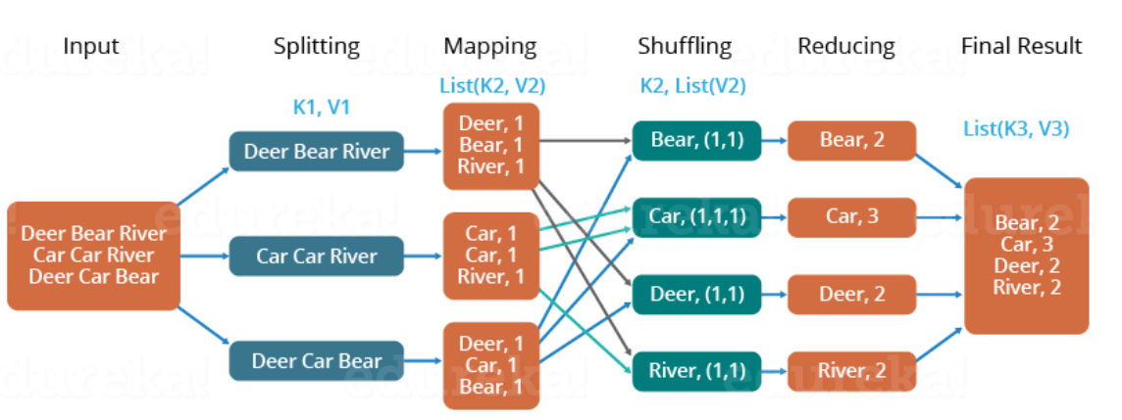
Example 2

Slide 43
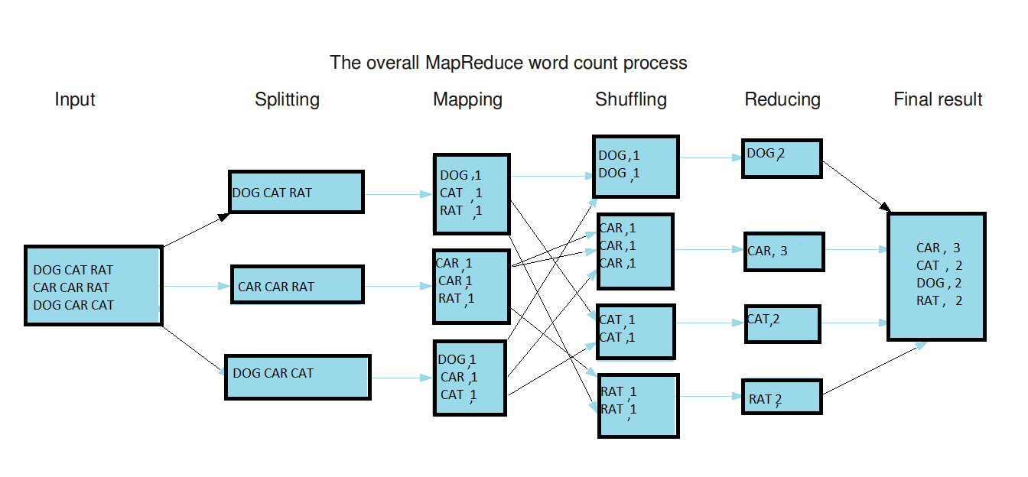
Example 2

Slide 44
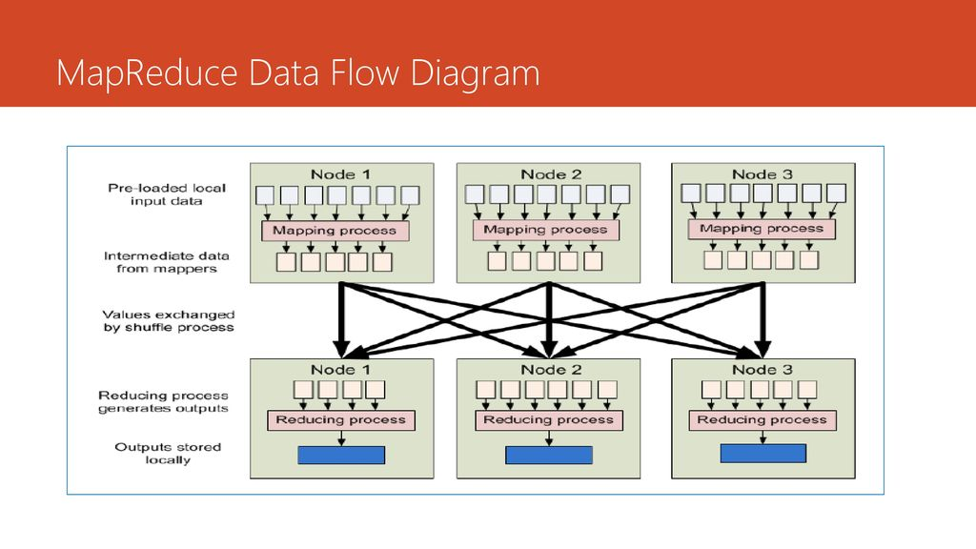

Slide 45
Summary

